Slide 1
Airline Satisfaction
Classification Project
Gottesman Nir
Musly Itzik
Rigler Gili
Shtein Anna Liya

Slide 2

Background
The data set contains a survey on air passenger satisfaction, filled by customers of some US airline company after their flight.
The main purpose of this dataset is to predict whether a future customer would be satisfied with their service and which aspect of the services offered by them have to be emphasized more to generate more satisfied customers.
The data consists of total 129,880 observations

Slide 3
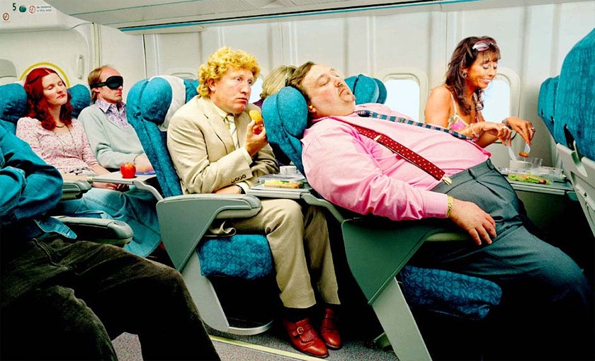
Data overview
Each row corresponds to one passenger, and each column to a specific feature:
Gender: male or female
Customer type: regular or non-regular airline customer
Age: the actual age of the passenger
Type of travel: the purpose of the passenger's flight (personal or business travel)
Class: business, economy, economy plus
Flight distance
Inflight wifi service: satisfaction level with Wi-Fi service on board (0: not rated; 1-5)
Departure/Arrival time convenient: departure/arrival time satisfaction level (0: not rated; 1-5)
Ease of Online booking: online booking satisfaction rate (0: not rated; 1-5)
Gate location: level of satisfaction with the gate location (0: not rated; 1-5)
Food and drink: food and drink satisfaction level (0: not rated; 1-5)
Online boarding: satisfaction level with online boarding (0: not rated; 1-5)
Seat comfort: seat satisfaction level (0: not rated; 1-5)
Inflight entertainment: satisfaction with inflight entertainment (0: not rated; 1-5)
On-board service: level of satisfaction with on-board service (0: not rated; 1-5)
Leg room service: level of satisfaction with leg room service (0: not rated; 1-5)
Baggage handling: level of satisfaction with baggage handling (0: not rated; 1-5)
Checkin service: level of satisfaction with checkin service (0: not rated; 1-5)
Inflight service: level of satisfaction with inflight service (0: not rated; 1-5)
Cleanliness: level of satisfaction with cleanliness (0: not rated; 1-5)
Departure delay in minutes
Arrival delay in minutes

Slide 4
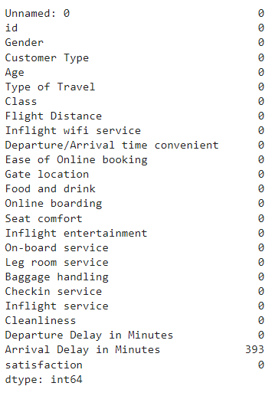
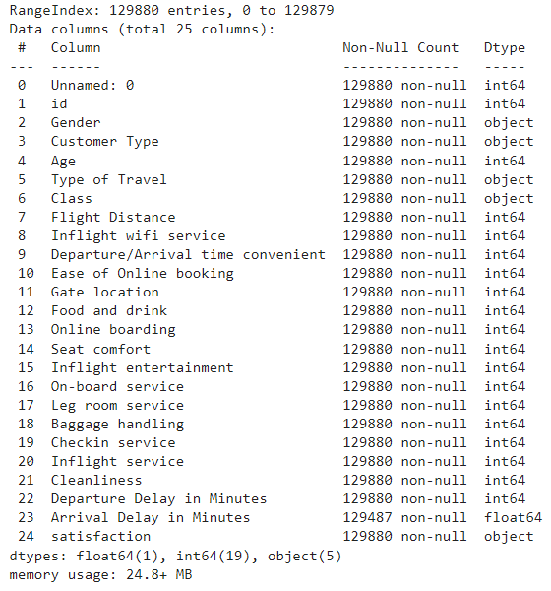
Data types and error values

Slide 5
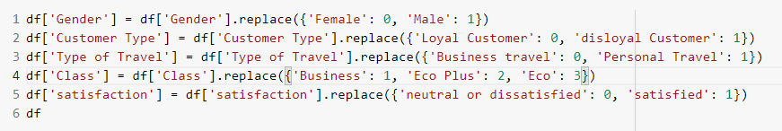

Data Cleaning
We had 393 missing values in “Arrival delay in minutes” field. After consideration of the data we came to the conclusion that this sample is insignificant to the dataset and we have decided to remove the rows with the missing values.
We handled categorical features by label encoding and replacing the strings with numerical values.
We removed the first two columns “Unnamed” and ‘’ID” as they were redundant.

Slide 6
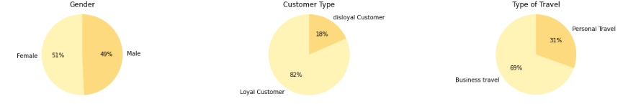
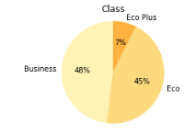
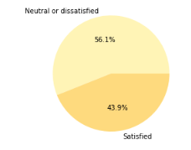

EDA

Slide 7
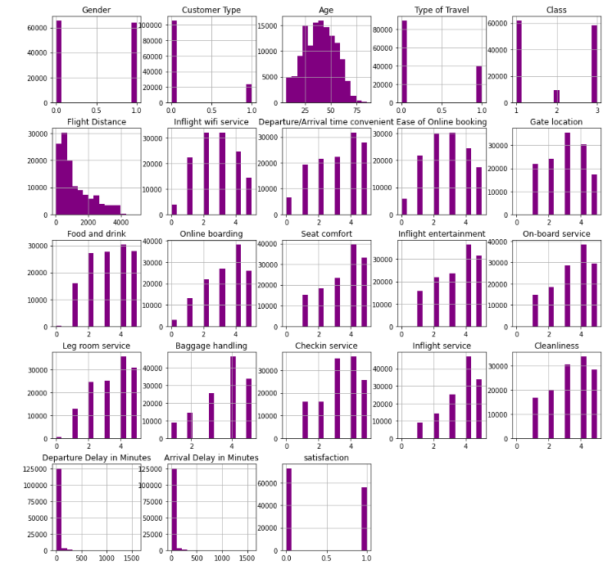
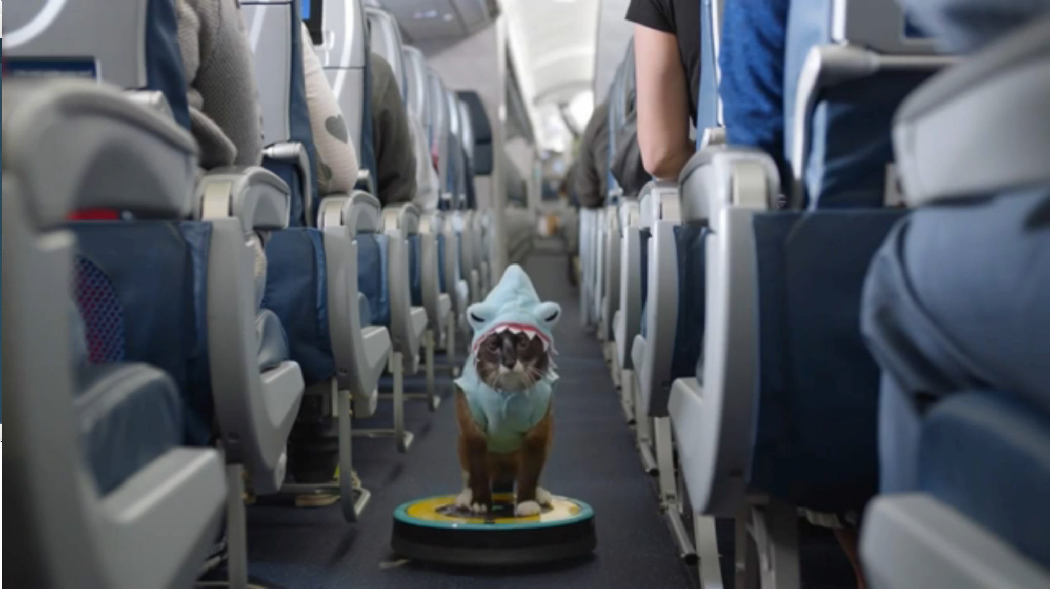
EDA

Slide 8
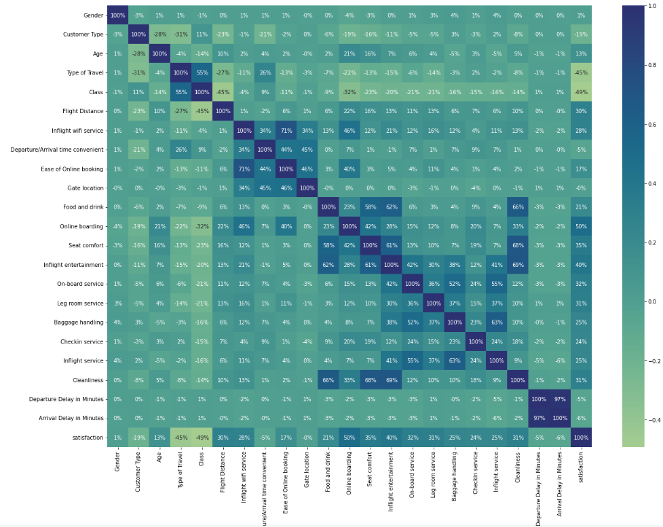
Correlation Matrix

Slide 9
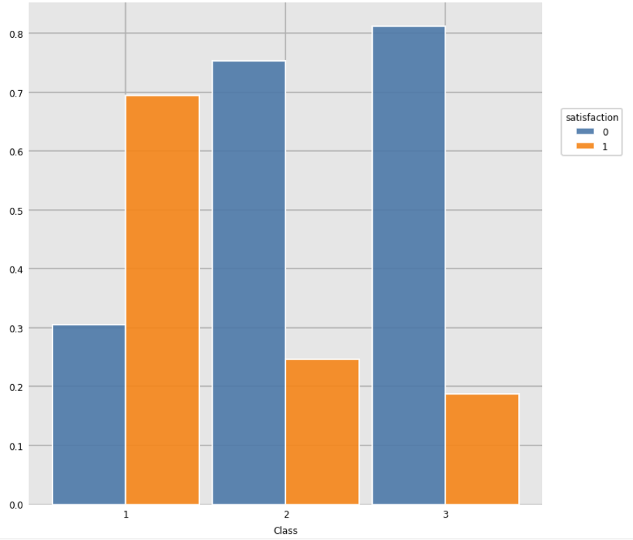
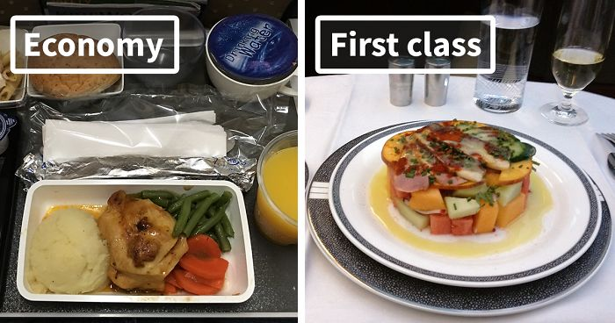

A few EDA Examples: When examining the relationship between the satisfaction and class we can see a high correlation. Passengers from the business class are more satisfied.

Slide 10
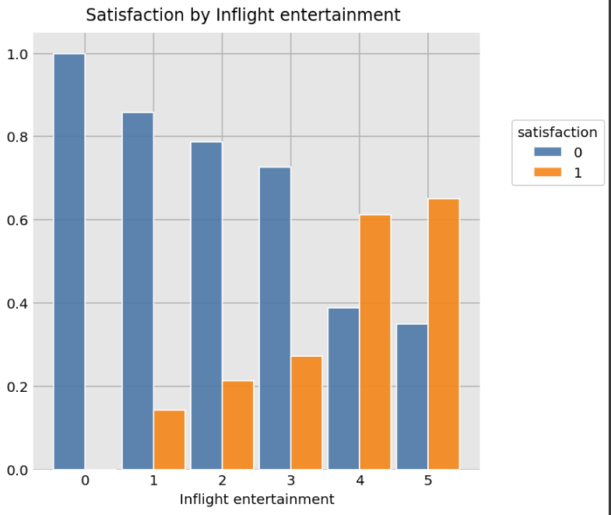
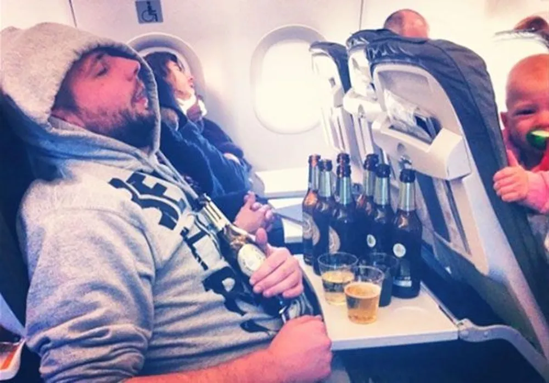
We see similar correlation between the customers’ grading of inflight entertainment and their overall satisfaction.

Slide 11

EDA Conclusions :
The sample is more or less balanced (56.7% on 43.3%) in terms of overall satisfaction.
The number of men and women in this sample is approximately the same.
The vast majority of the airline's customers are repeat customers.
Most of our clients flew for business rather than personal reasons.
About half of the passengers were in business class.
More than 60% of passengers were satisfied with the luggage transportation service (rating 4-5 out of 5).
More than 50% of passengers were comfortable sitting in their seats (rated 4-5 out of 5).
There was a strong correlation (96%) between the features 'Departure delay in minutes' and 'Arrival delay in minutes' (which is quite logical ).
Most of the airline's regular customers are between the ages of 30 and 50 (averaging a little over 40). The age range for non-regular customers is slightly smaller (from 25 to 40 years old, with an average of slightly less than 30).
Customers whose flight distance is long tend to fly in business class.
The more distance an airplane passenger travels (respectively, the longer they are in flight), the more satisfied they are with in-flight entertainment and extra legroom (on average).
Most of the passengers who flew in Economy Plus or Economy Class were dissatisfied with the flight, and those who were lucky enough to fly in Business Class were satisfied.
Almost all passengers who rated the wifi service 5 out of 5 were satisfied with the flight.
The majority of passengers who rated the comfort of the seats and the extra legroom at 4 and 5 points out of 5 were satisfied with the flight.

Slide 12
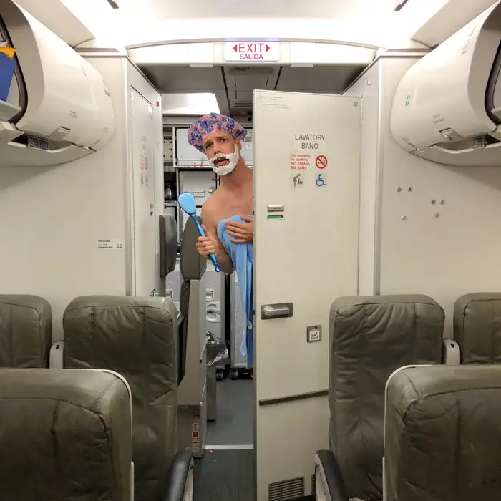
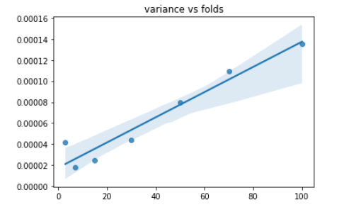
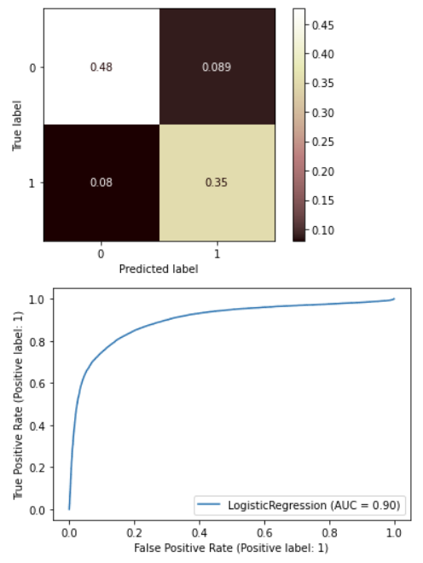
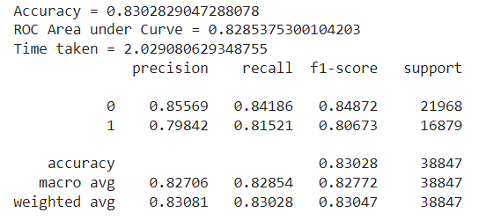
Classification Models
Logistic Regression

Slide 13
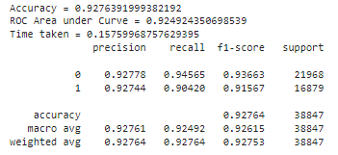
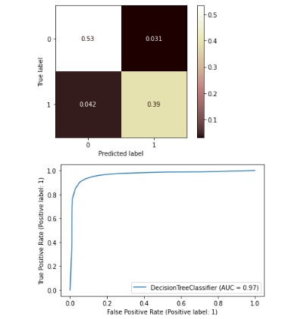
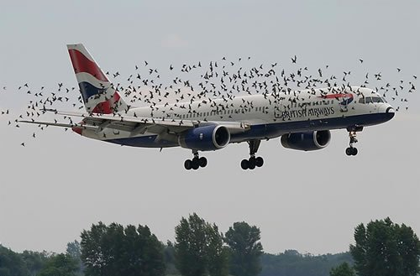
Classification Models
Decision Tree Classifier

Slide 14
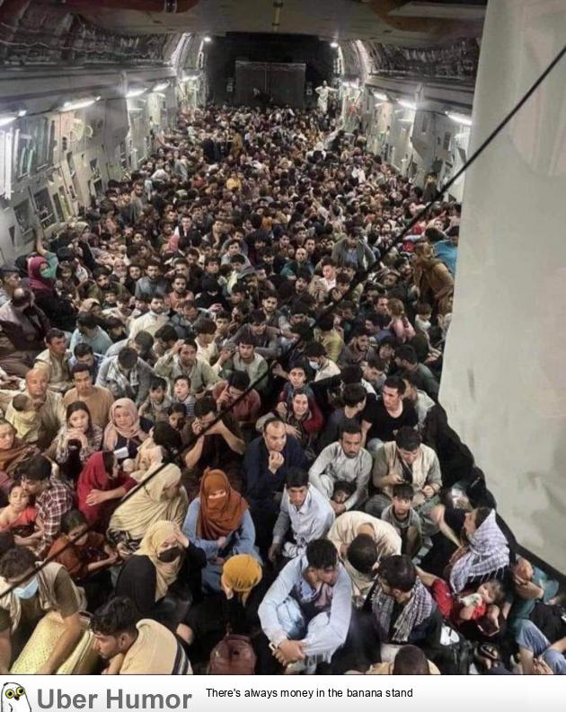
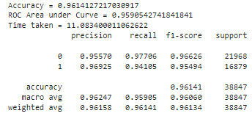
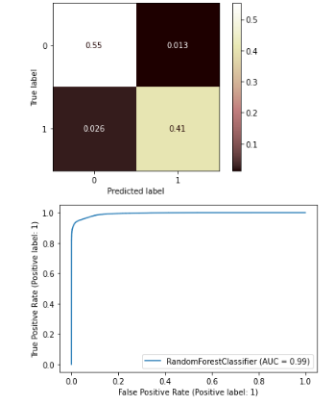
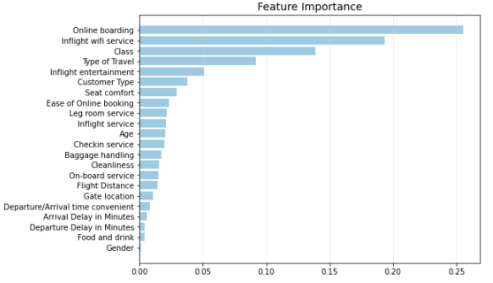
Classification Models
Random Forest Classifier

Slide 15
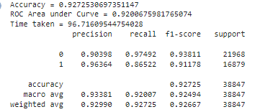
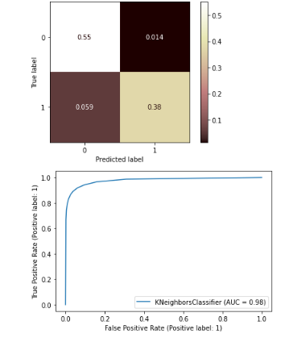
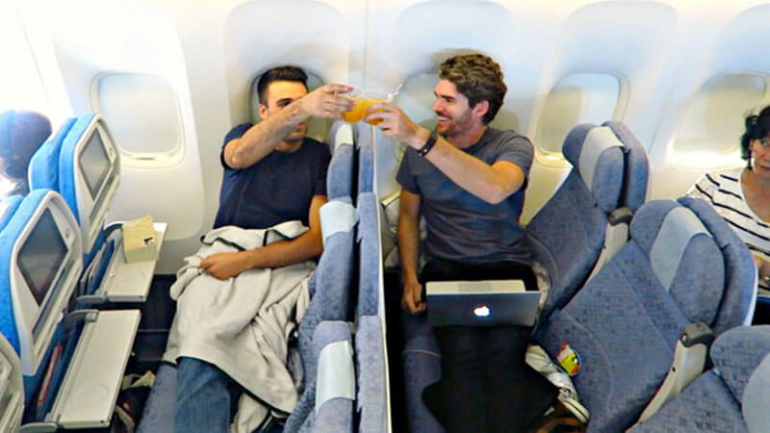
Classification Models
KNN

Slide 16
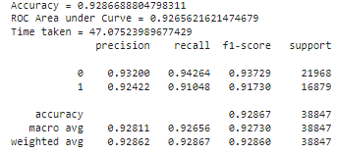
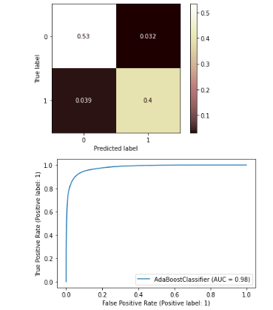
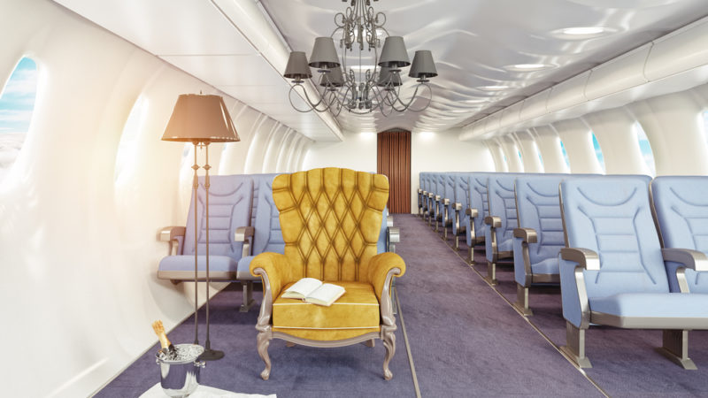
Classification Models
ADABoost Classifier

Slide 17
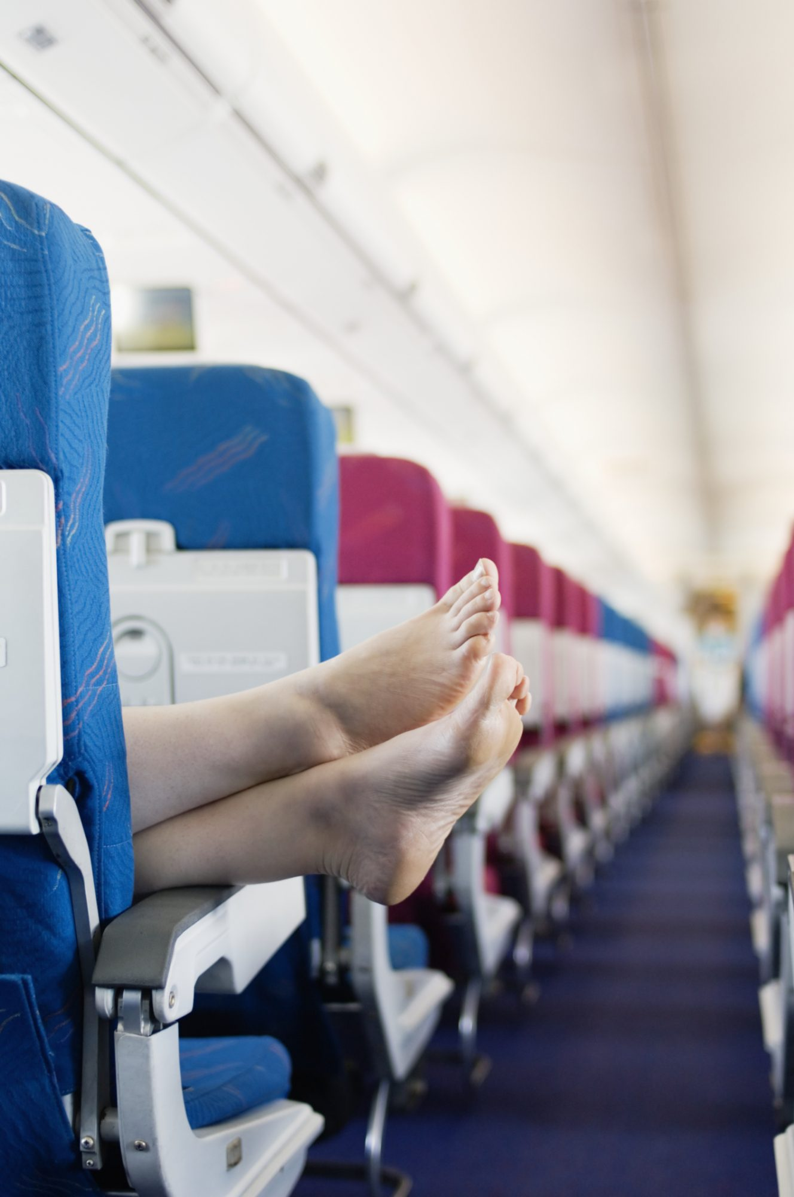
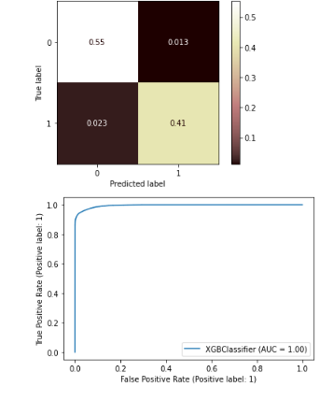
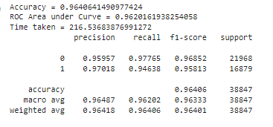
Classification Models
XGBoost Classifier

Slide 18
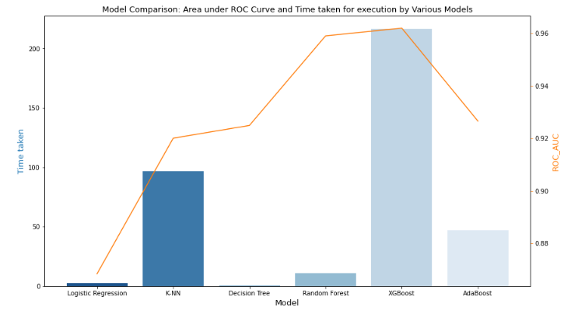
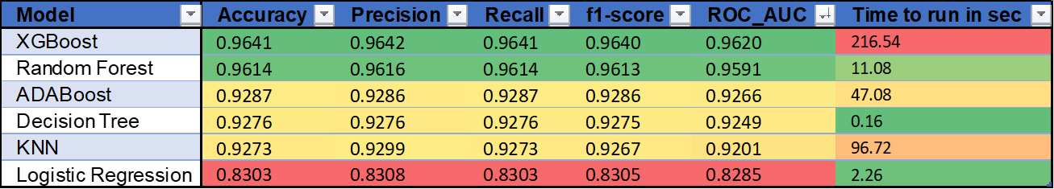
Model Comparison
We compare the performance of the models by the various scoring metrics and the total time taken for execution

Slide 19

Conclusion and next steps
Model:
We see that the Random Forest and XGBoost have performed equally well on producing high accuracy and ROC_AUC score, but the Random Forest model was better in terms of performance. Therefore, we chose the Random Forest as the "best model" for this data with accuracy of 96% in predicting customer satisfaction.
We’ll want to run more tests with different hyperparameters to try and improve other model's accuracy.
we would try and reduce the time to run the XGBoost as it had slightly better results.
We chose the ROC_AUC metric as the most important indicator in our prediction, we need to explore different business question that we may need to define different metrics or error fx.
From EDA:
Gender has no obvious effect on overall satisfaction and scores.
Passengers whose age is between 40 to 51 are more likely to be satisfied.
By looking at the visualizations and feature importance of model; services that affect satisfaction the most are Online boarding, Inflight wifi service, Inflight entertainment, Seat comfort, Cleanliness, and On-board service.

Slide 20

THE END!

